Slide 1

INTERNET AND MOBILE BANKING

Slide 2
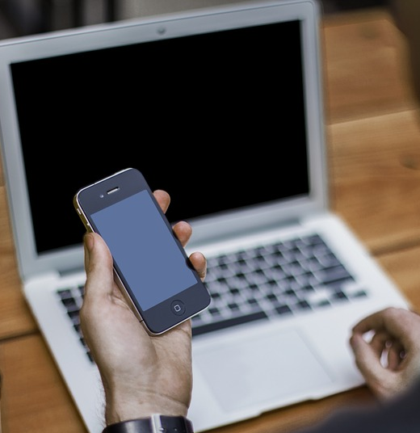
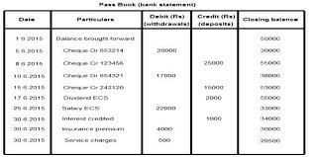
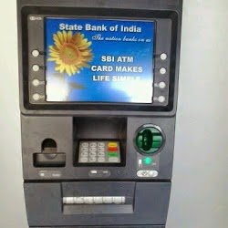
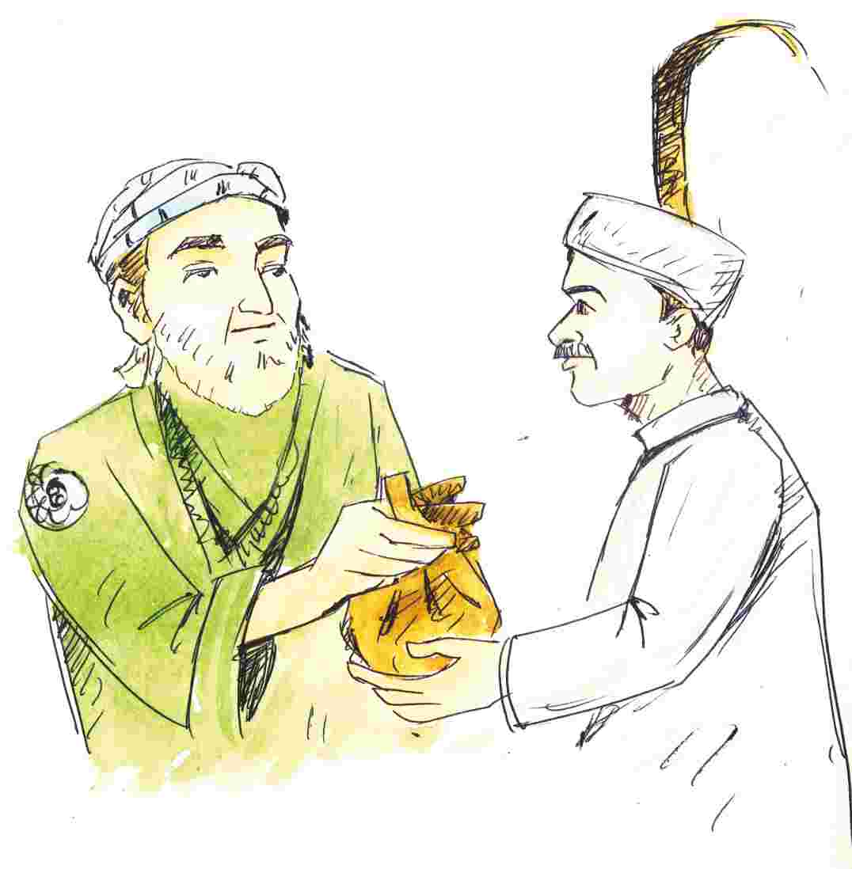
What change has come about in Banking?
Banking has become paperless!
You don’t need to visit a bank or even an ATM. You can directly use your smart phone or computer with an internet connection to do banking operations

Slide 3

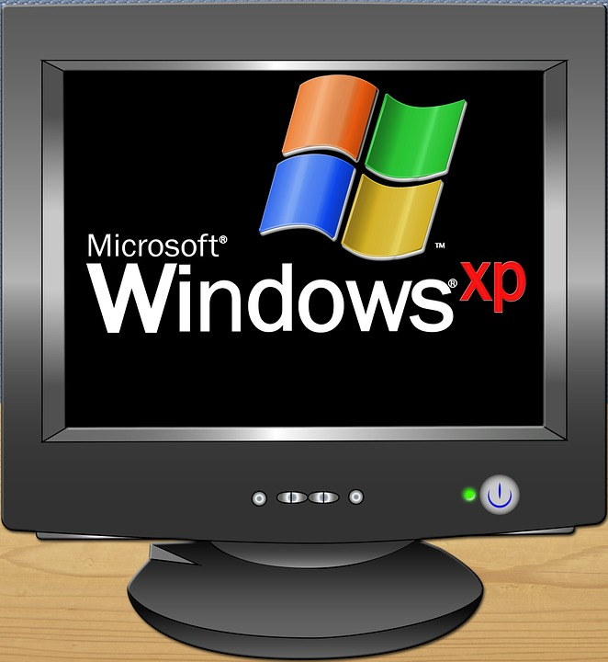
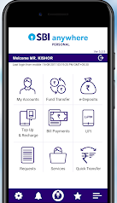
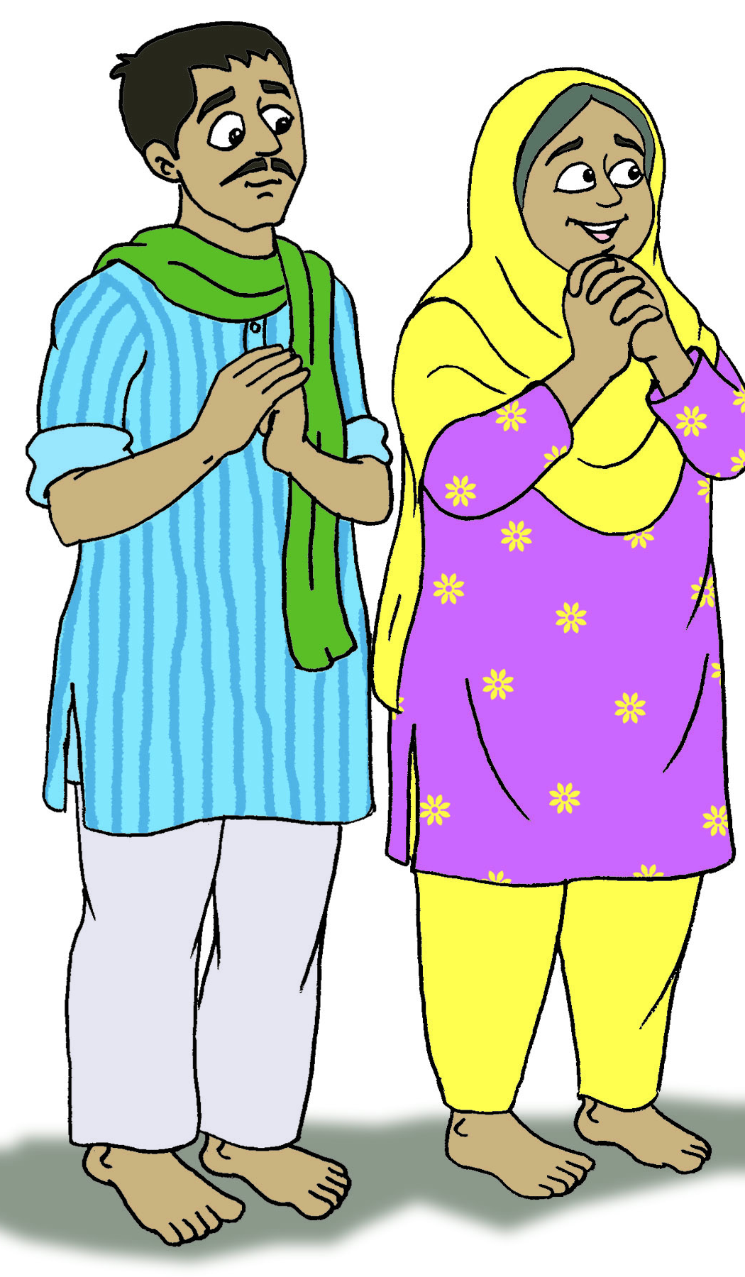
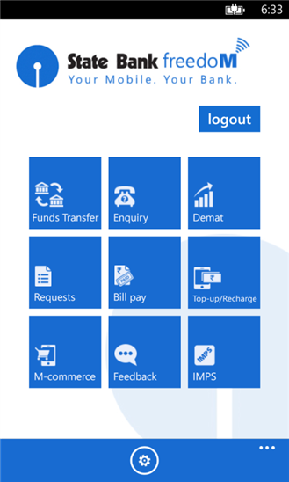
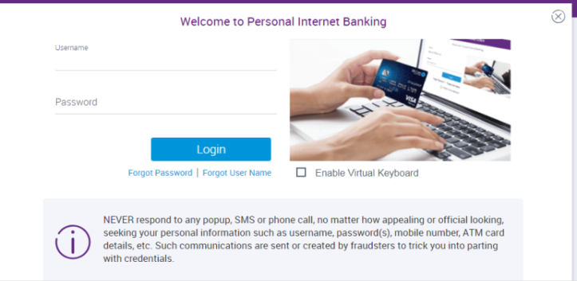
What is Internet / Mobile banking?
Either visit your bank website or download your bank’s app on your phone. Bank from anywhere!
You can use your smart phone or computer (with an internet connection) !
Our son has got admission in medical college. But he has to pay the fees soon. How can we send him money so quickly?

Slide 4
How do I transfer money between bank accounts?
NEFT
For any amount
Transfer after some time lag
RTGS
For Rs. 2 Lakh and above
Immediate transfer
Limit of Rs. 2 Lakh
Available 24 X 7
IMPS

Slide 5
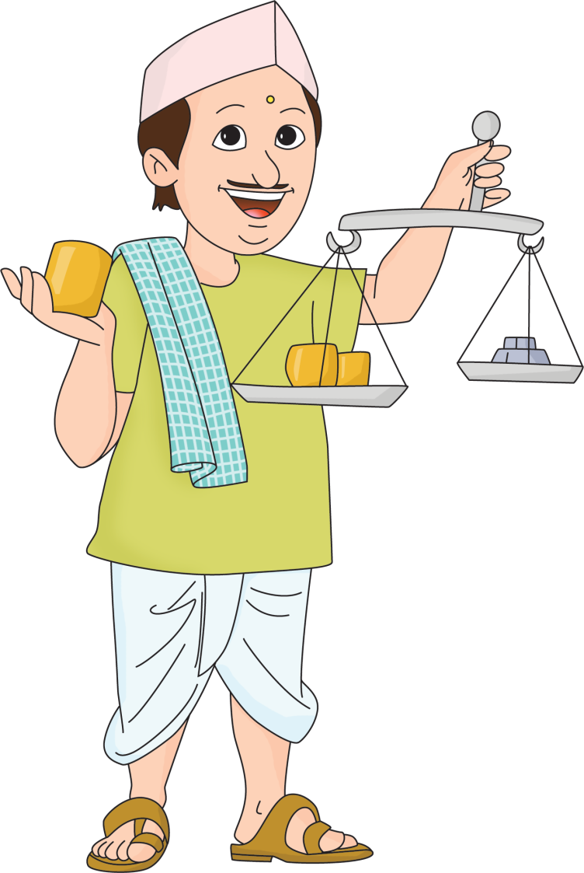
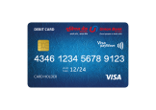
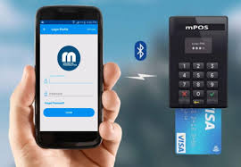
How else can I use mobile banking?
Luckily, I have a card swiping machine, that is linked to my bank account through my phone number
This customer came to my shop with no cash! Only a credit card!

Slide 6

What other payments can be made online?
Online Shopping – without visiting a store
Ticket Booking – without visiting a booking centre
Bill Payments – without visiting offices like the electricity office
Funds Transfer – paying money to other individuals or non individuals

